Slide 1
Innovative Projects Using Arduino (ECE2010) Phase –I Review Presentation Project P.A.W.S. (Pet Activity and Well-being System)
Submitted to the Presidency University, Bengaluru in partial fulfillment of the requirements for the Innovative Projects using Arduino
By
IPA-219
Under the supervision of
Mr. Asad Mohammad Khan
March 22nd , 2024
NAME | ROLL NUMBER
HARSHITH | 20231CIT0067
SYED M JUNAID | 20231CIT0068
KEVIN IMMANUEL M | 20231CIT0069
BHANU PRIYA | 20231CIT0070
BHAVANA | 20231CIT007
AKSHAY C M | 20231ECE0131

Slide 2
The Furbulator 3000 (Smart Pet Feeder)
Automated Feeding: An Arduino board equipped with a Real-Time Clock (RTC) module ensures your pet receives meals at pre-programmed times. A servo motor operates a lid, dispensing accurate food portions.
Food Level Monitoring: The feeder monitors the weight of the food container using a load sensor, allowing you to determine how much your pet has eaten.
Health Check: A room temperature sensor captures your pet's room temperature during feeding.
Data Logging and Monitoring: All collected data (feeding time, food dispensed, temperature) is logged and uploaded to a Firebase database via an ESP8266 Wi-Fi module.
Movement Monitoring: An ESP32 microcontroller paired with an accelerometer tracks your pet's activity levels, letting you know how much rest they're getting.
Wi-Fi Range Alert: The collar detects Wi-Fi signal strength. If the signal weakens beyond a set perimeter, you'll receive an alert, potentially indicating your pet has wandered too far.
The PawFit (Activity tracking collar)

Slide 3
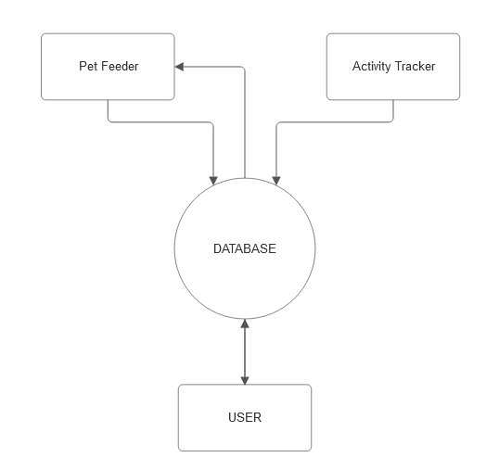
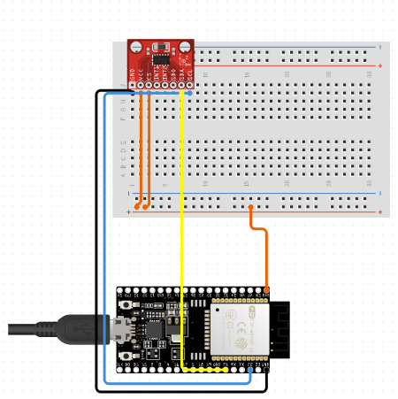
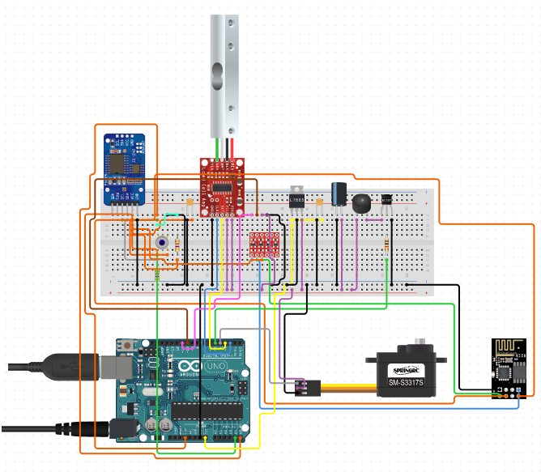
Circuit/Block Diagram

Slide 4
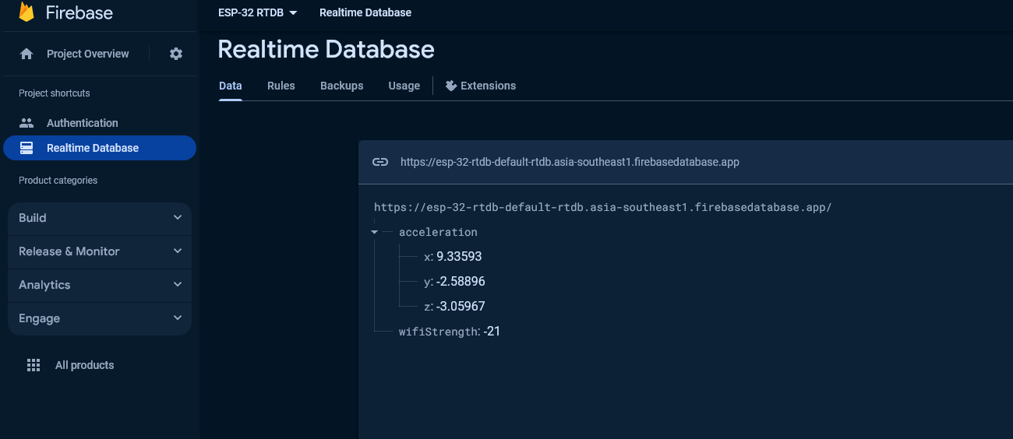
Setting Up Realtime Database

Slide 5
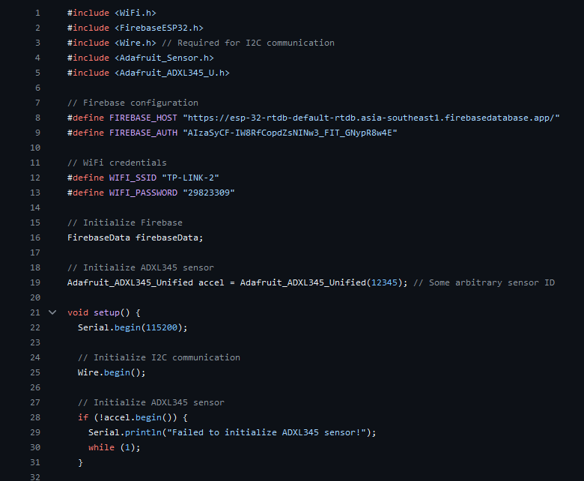
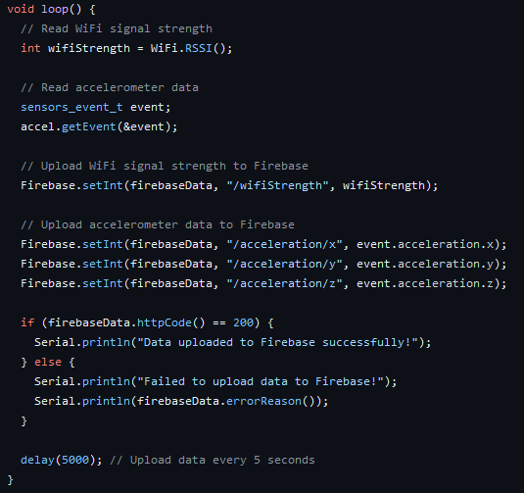
Setting Up firebase on both esp modules

Slide 6
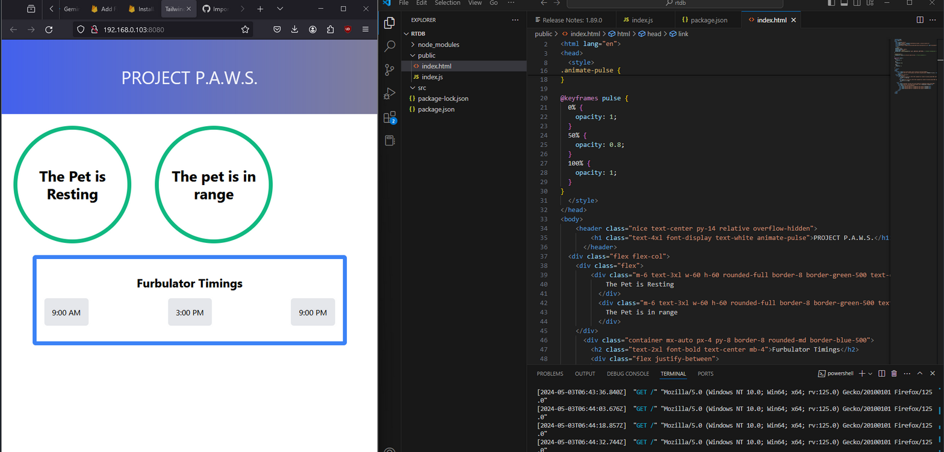
Displaying data on the Web App

Slide 7
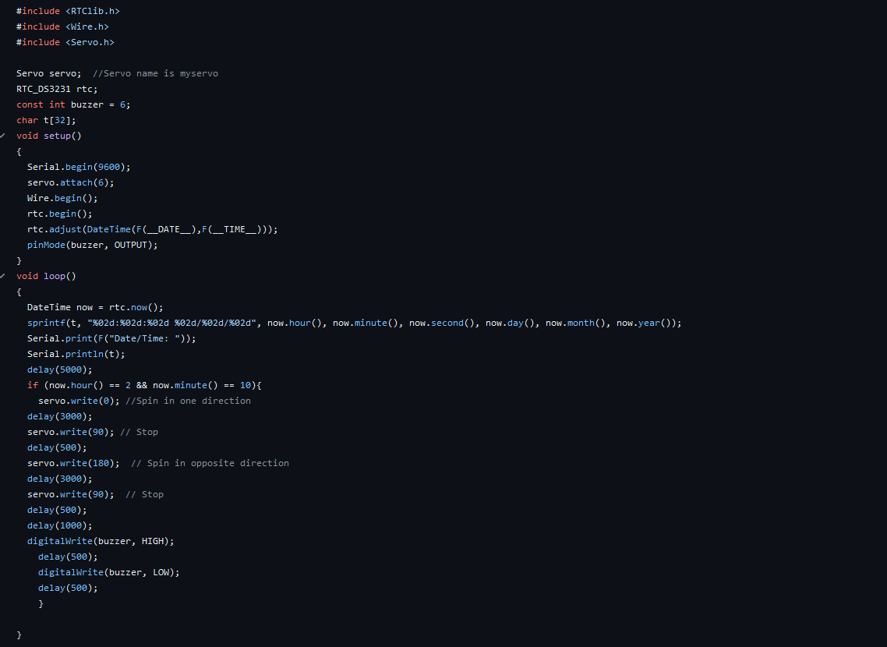
Writing code for servo and buzzer triggred by rtc module

Slide 8
Things need to be done
Implementing Load Cell to calculate how much food has the pet eaten since last time it was fed.
Implementing a room temperature sensor instead of ir temperature sensor due to limited resources.
Attaching the esp32-adxl345 to a collar.
Finally building the final Model using cans and attach servo motor to it.

Slide 9
Project Timeline
Phase 1
Phase 2
Phase 3

Slide 10
Challenges Faced in Project
Setting up firebase connection for esp32 module
Power management for rtc and servo motor from arduino board
Coding the esp32 and arduino
Coding web app using firebase realtime database

Slide 11
Q&A

Slide 12
Thank you !!

